Slide 1

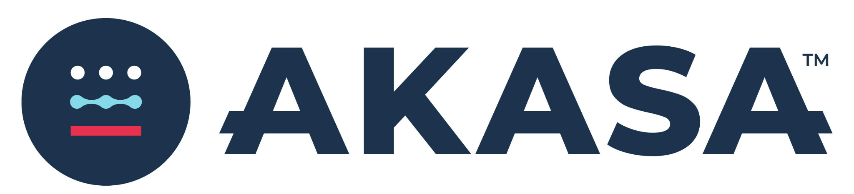
Transforming Healthcare Revenue Cycle Management Through Artificial Intelligence
Presented By:
Nina Barcelon
Paul Quimbo
Shahin Yaghinloo
Yatza Lo
Notes:
Power point: Just the questionnaire items

Slide 2
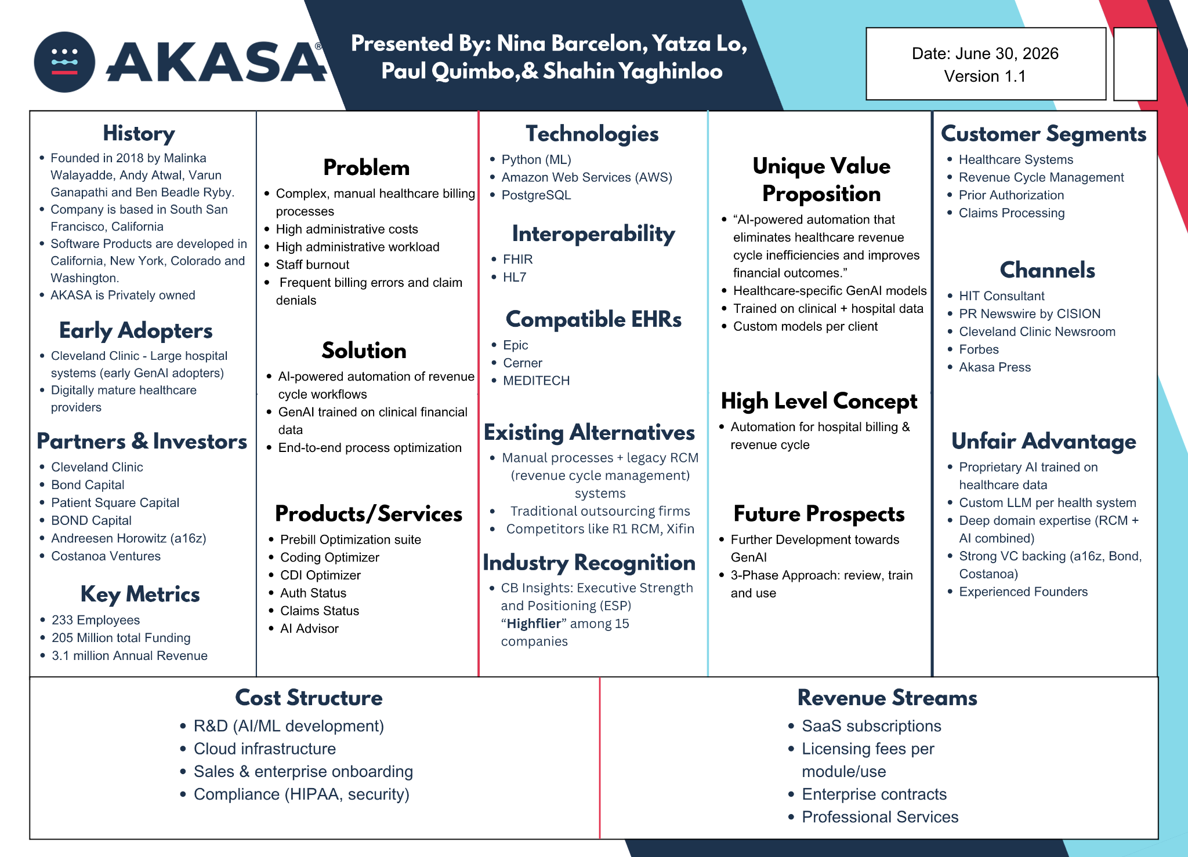
Notes:
This is our lean canvas. In this presentation, we will be covering all of the points the group has researched about this company, from its history to its revenue streams.
_____
Link to Canva: https://canva.link/n0x78u3vxje7hy2

Slide 3
Company Structure
Privately Owned,
Founded in 2018
Funded by private investors and partnership
Operates in US (CA, NYC, Remote)
Notes:
The company structure is as follows: it is a privately owned company, meaning it is not publicly traded and as such there is no stock ticker symbol and therefore, no current share price. More will be explained in the partnerships and investment section by Yatza. The company was founded in 2018 and funded by private investors and partnerships. AKASA operates in the United states and its headquarters is located in South San Francisco, California. And its R&D is distributed to different locations such as New York, Colorado, Washington along with opportunities for its employees to work remotely, thanks to their company’s focus on creating digital products
reference:
https://akasa.com/careers/?ashby_workplace_type=Remote#openroles

Slide 4
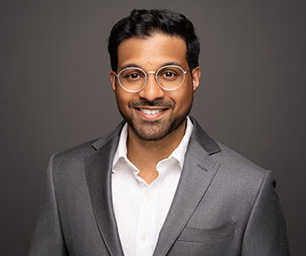
Leadership Team
Founders
  Malinka Walaliyadde (CEO)
  Andy Atwal (VP)
  Varun Ganapathi (VP Engineering & Advisor)
  Ben Beadle Ryby (Chief Revenue Officer)
Board Members
  Julie Yoo
  Noah Knauf
Advisor
  Toby Cosgrove
  Frank Williams
Finance & Operations
  Amy Raymond
  Ryan Roland
  Zach Barrett
Notes:
The leadership team consists of 4 co-founders, Malinka Walaliyadde as the CEO, Andy Atwal as the Vice President, Varun Ganapathi serving as an advisor and Ben Beadle Ryby as the chief revenue officer. The leadership team does have other board members. Julie Yoo and Noah Knauf are said members. Furthermore, its advisors consist of Toby Cosgrove the former CEO of Cleveland Clinic as well as Frank Williams who was the CEO and co-founder of Evolent Health and served as a chairman and CEO of the Advisory Board Company. For finance and Operations, Akasa’s executive team has Amy Raymond, Ryan Roland and Zach Barrett.
Reference:
https://akasa.com/leadership
https://www.thecompanycheck.com/company/b/akasa/7rsqhwebebgtub19s

Slide 5

What healthcare problem are they trying to solve? How?
The Problem
Hospitals spend a lot of time on billing, coding, and insurance tasks
Work is complex, slow, and error-prone
Staff shortages make it harder to keep up
AKASA’s Solution
Uses AI to automate administrative work
Reads patient records
Assigns accurate medical codes
Helps with insurance approvals
Catches errors before claims are sent

Slide 6

Estimated Funds and Revenue
Estimated Funds
CBInsights: $205M total funding raised
$120M Series C (2024)
Estimated Revenue
LeadIQ: ~$3.1M Annual Revenue
Executive Strength and Positioning (ESP)
CB Insights: “Highflier” among 15 companies
Notes:
What is the company worth? What are their annual sales?
AKASA’s annual revenue is currently 3.1 million dollars per year.
They have 233 employees across 5 continents, including North America, Asia, and Africa.
AKASA’s current total funds is $205 million dollars with large undisclosed investment of 120 million dollars in June 18th, 2024
References
https://growjo.com/company/AKASA
https://www.cbinsights.com/company/alpha-health/financials
https://leadiq.com/c/akasa/5ea7280660fe562750119bdf#media
https://www.cbinsights.com/company/alpha-health/financials
https://www.cbinsights.com/company/alpha-health

Slide 7

Partnerships and Investors
Partnerships
Cleveland Clinic
Investors
Patient Square Capital
Andreessen Horowitz (a16z)
BOND Capital
Costanoa Ventures
Jim Momtazee
Notes:
If the company is a startup, who is funding them, and how much funding have they received?Who are their major partners?
AKASA is funded by several leading venture capital firms, including Patient Square Capital, Bond Capital, Costanoa Ventures, and Andreessen Horowitz, also known as a16z.
In total, the company has raised approximately $205 million in funding since its founding in 2018. This includes a $60 million Series B round in March 2021, backed by Bond Capital, Andreessen Horowitz, and Costanoa Ventures, as well as an additional $120 million Series C round announced on June 18, 2024, with undisclosed investors.
In addition to its investors, AKASA has a major healthcare partnership with the Cleveland Clinic, which also validate and support the company’s AI-powered revenue cycle solutions in real-world clinical settings.
Together, these funding rounds and partnerships reflect strong investor and industry confidence in AKASA’s AI-powered healthcare platform and its long-term growth potential.
Overall, this positions AKASA to continue expanding in the healthcare technology market in the years to come.
References:
https://patientsquarecapital.com/team/jim-momtazee
https://www.axios.com/2019/04/24/mary-meekers-new-firm-raises-125-billion-1556126061
https://venturebeat.com/ai/costanoa
https://www.costanoa.vc/team?category=investors
https://www.thecompanycheck.com/company/b/akasa/7rsqhwebebgtub19s

Slide 8
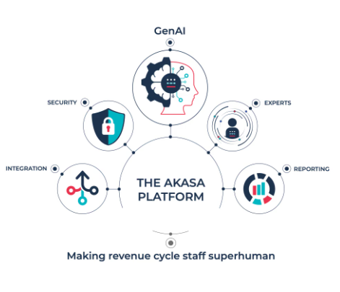
Platform Solutions
Prebill Optimization Suite
  Custom LLM
  Flag documentation gaps and missed codes
  Actionable Recommendations
Coding Optimizer
  Identify documentation gaps
  Identify missed revenue
  quality metric
  denial and compliance risks
  approve codes with confidence
CDI Optimizer
  Dashboard to identify and prioritize DRG,impact and quality indicators
  Quick access to quotes and links to clinical documentation
  Embedded coding guidelines, codebooks, and streamline clinical validation process.
Auth Status
  optimizing prior authorization requests and documentation of results.
Claim Status
  optimizing claims processing by prioritizing follow-up and problematic accounts
AI Advisor
  provides NLP support the revenue cycle team to answer clinical questions more efficiently
Notes:
Do they sell hardware, software, services, or a mix?
What are their most significant products?
AKASA is a software company that provides a Software-as-a-Service, or SaaS, platform for revenue cycle management. Its platform includes six AI-powered solutions that help healthcare organizations automate and optimize different parts of the revenue cycle workflow.
One of its flagship products is the Prebill Optimization suite, which uses generative AI to improve inpatient encounter prebilling. The solution identifies documentation gaps and missed coding opportunities before claims are submitted. It works in three main steps. First, AKASA trains its custom large language models using an organization's billing and patient data.
Second, their AI model re-analyzes billing encounters, identifies documentation gaps or invalid codes,
and provides actionable recommendations supported by clinical evidence, coding references, and confidence scores.
Finally, the suite includes Coding Optimizer and CDI Optimizer, which help coders and Clinical Documentation Integrity staff review and resolve billing issues through dedicated workflows.
Another product is Auth Status, which automates prior authorization requests and documents the results. Claims Status solution - prioritizes accounts that require follow-up by assigning higher follow-up scores to problematic claims, helping revenue cycle teams focus on the highest-priority work. Finally, AI Advisor is a conversational AI assistant that helps revenue cycle teams answer clinical and coding-related questions more efficiently.
References
https://businessmodelcanvastemplate.com/blogs/how-it-works/akasa-how-it-works?
https://akasa.com/solutions

Slide 9

Software As A Service Subscription Options
Enterprise contracts
Volume Based Subscriptions
Transaction Fee for High-value flows
Performance Aligned fees
Professional Services
Notes:
What is their business and/or delivery model?
How do they make or plan to make money?
As mentioned in the previous slide, Akasa is a healthcare AI company that delivers its revenue cycle management software through a cloud-based Software as a Service, or SaaS, model.
Akasa generates revenue through several pricing strategies. Its primary source of revenue is its enterprise SaaS subscriptions, which are typically sold through multi-year enterprise contracts.
For smaller health systems, Akasa also offers a volume-based subscription model, where pricing is based on the number of claims processed or the patient encounter volume.
Additionally, transaction-based pricing is offered for Autopilot Prior Authorization,
as well as performance-based fees for denial recovery, where pricing is tied to the value delivered rather than utilization.
Finally, Akasa offers professional services to support implementations, custom workflow mapping, and training for revenue cycle staff.
References:
https://businessmodelcanvastemplate.com/blogs/how-it-works/akasa-how-it-works?

Slide 10
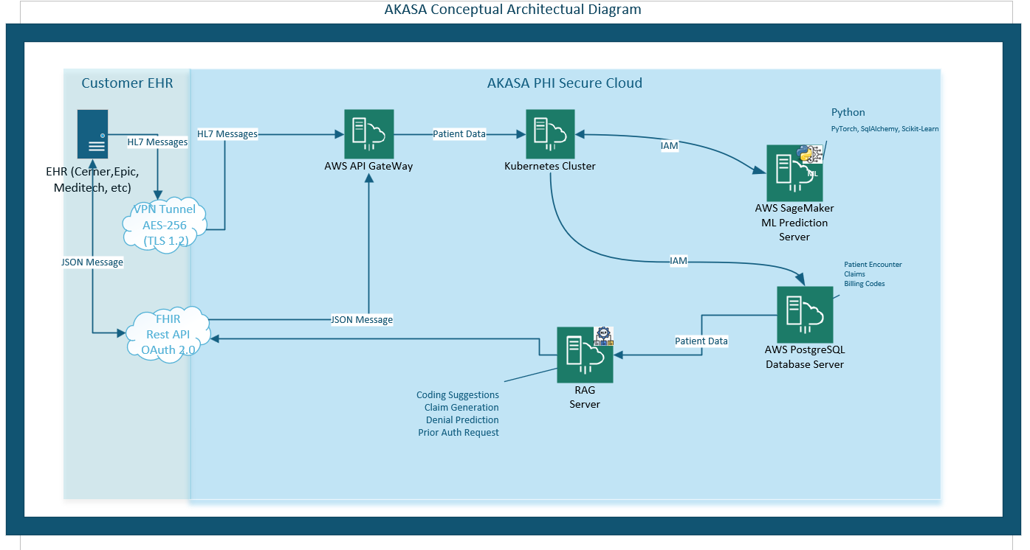
Conceptual Architecture
Notes:
While AKASA provides limited information about its technical infrastructure on its website, we can infer some of the technologies it uses from its engineering job postings and technical marketing documentation.
Based on those resources, AKASA appears to use Amazon Web Services, or AWS, as its cloud platform, along with Kubernetes for container orchestration, PostgreSQL for data storage, and Python with machine learning libraries such as SQLAlchemy, scikit-learn, and PyTorch to develop and deploy its AI models. The company also supports interoperability with various electronic health record, or EHR, systems through HL7 and FHIR integration standards.
The diagram shown on this slide is a conceptual representation of AKASA's architecture based on the technologies the company references publicly.
This is not an official architecture diagram, but rather an illustration of how these technologies likely work together to support its AI-powered revenue cycle management platform.
As shown in the diagram, data from an EHR system is securely ingested into an AWS cloud environment using FHIR APIs and VPN connections that support both HL7 and JSON-based integrations. The data is then processed within a Kubernetes cluster, which orchestrates communication between the machine learning prediction server and the PostgreSQL database. A Retrieval-Augmented Generation, or RAG, server accesses the patients clinical and billing data to generate coding recommendations, support claims processing, predict claim denials, and prior authorization requests.
References:
https://businessmodelcanvastemplate.com/blogs/how-it-works/akasa-how-it-works
https://akasa.com/careers/?ashby_jid=fd805dcf-7d8e-4f7d-b74c-6cafc32cf890#openroles

Slide 11


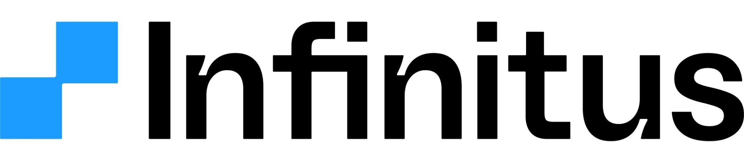
Who are their major competitors?
AKASA’s primary competitors consist of R1, Thoughtful AI, and Infinitus. These three companies compete in providing similar services and products for healthcare revenue cycle management.
R1 RCM
Thoughtful Ai
Infinitus
Notes:
NINA
AKASA’s primary competitors consist of R1, Thoughtful AI, and Infinitus. These three companies compete in providing similar services and products for healthcare revenue cycle management.
R1 RCM is more traditional company compared to Akasa with the company having more than 20 years of Industry experience, Thoughtful AI and Infinitus. R1 has Full service outsourcing partner for end-to-end automation of revenue cycling such as billing, coding and claims. Primary focus on AI agents but still employs onsite staff.
Thoughtful AI: Has compatibility with both cloud-based and on premise integration. Thoughtful Ai focuses specifically on AI agents development and deployment with pre-existing RCM stacks.
Infinitus key distinction is that it is used for phone based tasks for benefit verification, prior authorization and follow-ups. It's also uniquely focused on patient-facing and payer-facing conversations, not just back-office workflows
Specific Differences and notes: In comparison to the following companies, AKASA primarily focuses on generative AI for Epic and Cerner systems which is more geared towards hospital systems. AKASA does not require on premises integration.

Slide 12
What are the company’s future prospects? Where are they headed?
Development and application of GenAI into operations and administrative work.
Three Phase Plan
Review mode
Co-pilot mode
Autonomous mode
Notes:
AKASA’s future prospects focus on the development and application of GenAI into operations and administrative work. By using Large Language Models, GenAI would be used towards clinical intake and revenue cycling. The primary path for AKASA is headed towards creating infrastructure for GenAI use in revenue cycling by utilizing a three-phase approach to review, train and use its developed product.
In the first step of review mode, AKASA’s Gen AI would use a customized LLM to review encounters for optimization.
In the next step of Co-pilot mode, integration of GenAI suggestions would be fed into the CDI and coding to help save time for clinicians and staff. It is here where metrics in accuracy and quality can be tracked for improvement.
For the last phase, Autonomous mode would enable the Gen AI to automate direct-to-bill actions based on recommendations of high confidence. This would help reduce backlog and minimize costs to collect which helps improve turnaround times.

Slide 13
Thank You for Listening
Notes:
Thank you for listening to our presentation on AKASA. Please feel free to ask us questions in the comments. Take care and Have a nice day.

